Slide 1
Choosing the right location to move in during work travel
Jesus Saravia | Coursera| Beginner

Slide 2
Introduction
In these modern days where people travel across the world to work in different companies for learning or working on site there is a necessity to find the right place to stay and avoid putting to much effort in time in finding the place to live during that period
So we propose a way to find the location according to the predefined needs or likes to choose the right place where to live
Notes:
Insert a map of your country.

Slide 3

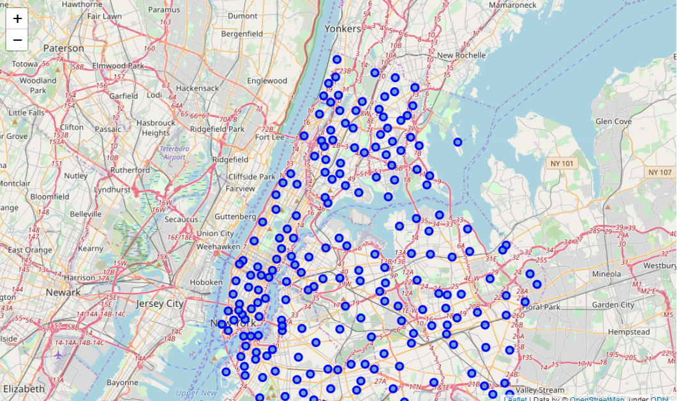
DATA ACQUISITION AND CLEANING
The data will be used as follows:
• Use Foursquare and geopy data to map top 10 venues for all Manhattan neighborhoods and clustered in groups
• Use foursquare and geopy data to map the location of subway metro stations, separately and on top of the above clustered map in order to be able to identify the venues and amenities near each metro station, or explore each subway location separately
Notes:
Insert a picture of one of the geographic features of your country.

Slide 4
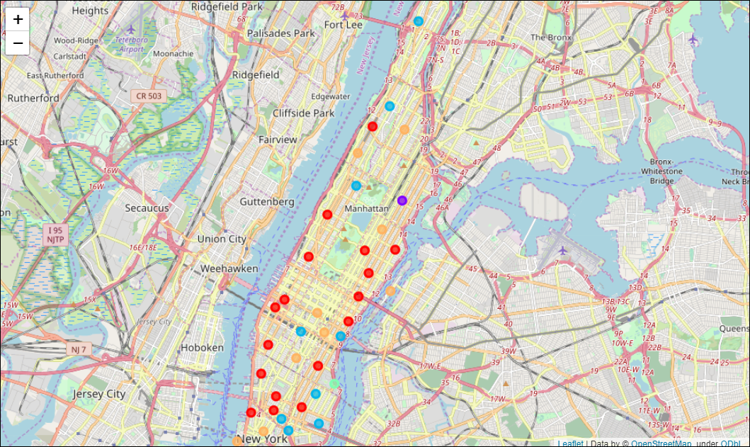
Methodology AND RESULT
First, we specify the Area of interest, in this case we use Manhattan, after that we found the Borough and Neighborhood
After that we query the venues at a ratio of 500m around each neighborhood and filter the data according to the customer requirements which in this case are:
Desired location is near a metro station
Desirable to have venues such as coffee shops, restaurants, wine stores, gym and food shops
After the queries and filtering we apply K-means to create 5 clusters which share similarities in order to show to customer the matching areas and then he can select the most suitable
Notes:
Insert a picture illustrating a season in your country.

Slide 5
Conclusion
By using the methods described above we can select most suitable places according to the requirements of customers and we can even input locations of the companies in which people will work to select the venues near these locations and make this model more complex
Notes:
Insert a picture of an animal and or plant found in your country.

